Slide 1
Express Js

Slide 2
What is Express ?
Fast and minimalist web framework for Node.js (from expressjs.com)
Web application framework that provides a robust set of features
Many third-party middleware to extend functionality
Express is a routing and middleware web framework that has minimal functionality of its own

Slide 3
Express Middleware
Middleware provide a lot of plug-in functionality that can be used within your Express application
Middleware functions can perform the following tasks:
Execute any code.
Make changes to the request and the response objects.
End the request-response cycle.
Call the next middleware function in the stack.

Slide 4
Tour Of Node Module
Examine package.json file
npm install can specify the acceptable package version:
npm install express
npm i express

Slide 5
Representational State Transfer (REST)
A style of software architecture
A collection of network architecture principles which outline how resources are defined and addressed
Exchange of data using either XML or JSON

Slide 6
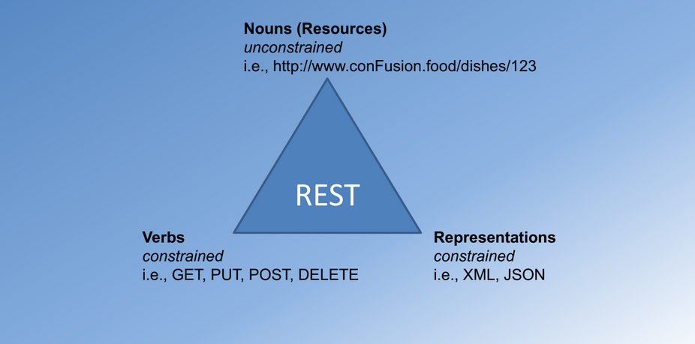
REST Concept

Slide 7
1. Resources
Represented with a global identifier (URI in HTTP)
http://github.com
REST uses URI to identify resources
http://github.com
http://www.github.food/Shubhamdutta2000/
http://www.github.com/samratc030/

Slide 8
2. Verbs
Represent the actions to be performed on resources
Corresponding to the CRUD operations
HTTP GET =>READ
HTTP POST => CREATE
HTTP PUT => UPDATE
HTTP DELETE => DELETE

Slide 9
3. Representation
How data is represented or returned to the client for presentation
Two main formats:
JavaScript Object Notation (JSON)
XML

Slide 10
Express Routes
Routing is how you direct the user's requested URL to
retrieve the appropriate 'page’ => GET
save the submitted form => POST
Identify an end point with a URI
Apply the verb on the URI (Apply REST

Slide 11
Express Routes with Params
Example:
app.get('/dishes/:dishId', (req,res,next) => {
res.end('Will send details of the dish: ’ + req.params.dishId
+’ to you!’)
});

Slide 12
Body Parser
Middleware to parse the body of the message
Using Body Parser:
var bodyParser = require('body-parser');
app.use(bodyParser.json()); // parse the JSON in the body
Parses the body of the message and populates the req.body property

